Slide 1
Activity Diagram
UML diagram

Slide 2
Activity Diagrams
Activity diagram shows flow of control or object flow with emphasis on the sequence and conditions of the flow.
The actions coordinated by activity models can be initiated
because other actions finish executing,
because objects and data become available,
or because some events external to the flow occur.
UML activity diagrams elements:
activity,
partition,
action,
object,
control,
activity edge.

Slide 3
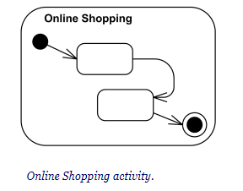
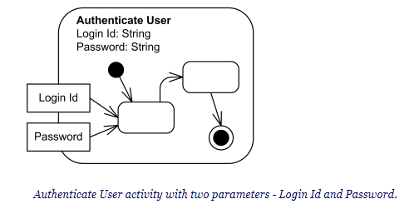
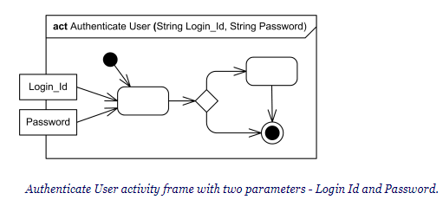
Activity
Activity is a parameterized behavior represented as coordinated flow of actions.
It can be a simple action or a complex set of actions.
Example: In a software development process, "Design Database Schema" is an activity. It can be further decomposed into sub-activities like "Create Entity-Relationship Diagram" and "Define Table Structures.“
Activity nodes also include flow of control constructs, such as synchronization, decision, and concurrency control.
Activity contains activity nodes which could be:
action
object
control

Slide 4
Example
Let's consider the process of making a sandwich as an activity:
Gather Ingredients
Prepare Bread
Add Condiments
Add Fillings
Combine Slices
Activity Diagram Connection
Represent each of these steps as "activity nodes.“
The arrows or lines connecting these nodes indicate the flow of the process.
Symbols like diamonds to represent decisions, which help determine whether to add condiments or not, for instance.
Parameterized Behavior (parameter-name: parameter-type.)
When you're adding cheese to your sandwich, you might specify the type of cheese you want (parameter)
These parameters help customize the behavior of an action
Preconditions and Postconditions ( «precondition» and «postcondition»)
there's a precondition - you need to have all the ingredients
there's a postcondition - you have a sandwich to eat.
Single Execution («singleExecution»)
it's a single shared execution because you're making one sandwich.
In contrast, imagine a chef in a restaurant preparing multiple sandwiches - each customer's order is a separate execution

Slide 5
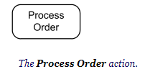
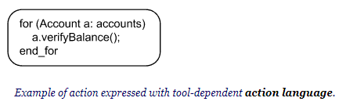
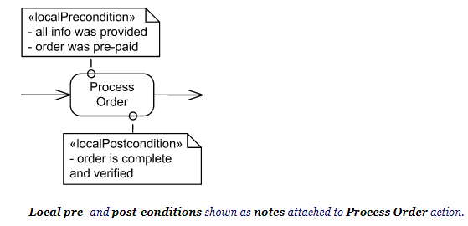
Actions
Action is a named element which represents a single atomic step within activity, i.e. that is not further decomposed within the activity.
Activity represents a behavior that is composed of individual elements that are actions.
Name of the action is usually action verb or noun for the action with some explanation
Fill Order
Review Document
Enroll in Course
Checkout
Show Error Page
An action may have sets of incoming and outgoing activity edges that specify control flow and data flow from and to other nodes.

Slide 6
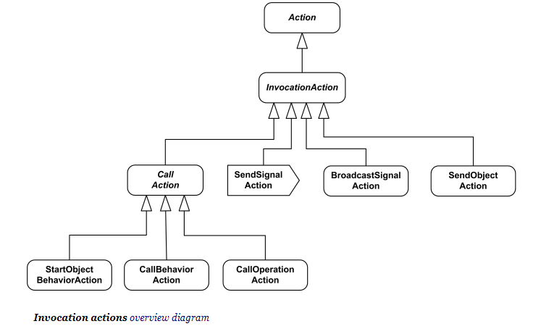
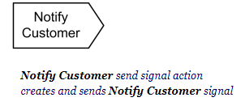
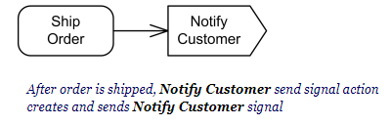
Actions Subclasses
Object action (not explicit in UML standard) - include different actions on objects, e.g. create and destroy object, test object identity, specify value, etc.
Variable action - variable read, write, add, remove and clear actions
Invocation action - several call actions, signal send and broadcast actions and send object action
Call behavior action is a call action that invokes a behavior directly rather than invoking an operation that invokes the behavior.
synchronous calls, asynchronous
Send signal action is an invocation action that creates a signal from its inputs, and transmits it to the specified target object, where it may cause the firing of a state machine transition or the execution of an activity.
Raise exception action
Structural feature action
Link action
Event action (not explicit in UML standard)
Opaque action

